Slide 1
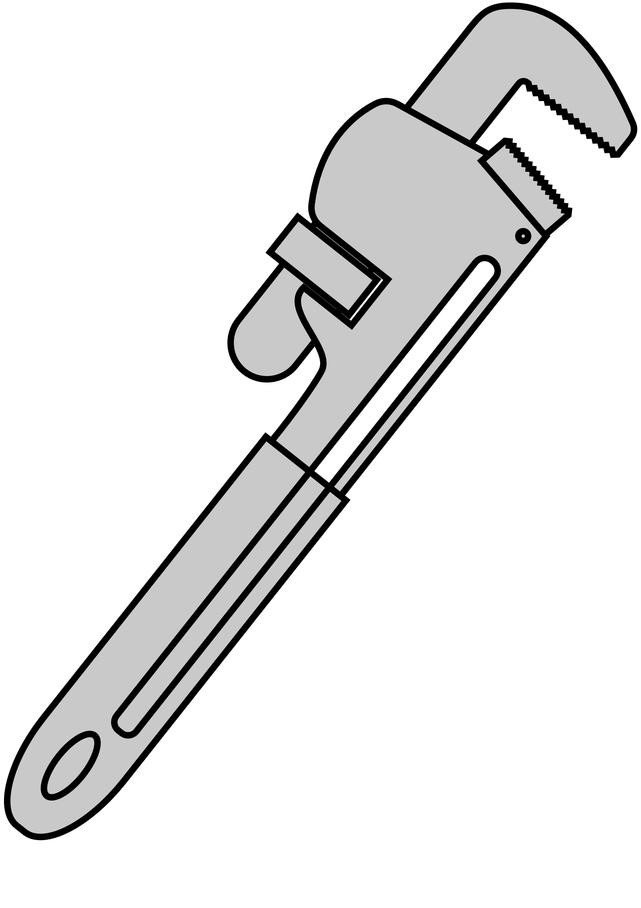
Tool
Time

Slide 2
Rent - Buy - Borrow
Search Between Local Stores and Tool Owners.
Let your neighbors borrow tools.
Rent your tools out, or invite people to utilize your workshop.
Cant find a tool? See if your local hardware stores have it in stock.

Slide 3
Create an account, write a little about yourself
Looking for a tool? Use the search box.
Have tools collecting dust? Start a new listing.

